Slide 1
How to engage end-users in smart energy behaviour?
Pieter Valkering, VITO

Slide 2
Basic information
S3C – “Smart consumer, smart customer, smart citizen”
FP7 – Energy.2012.7.1.3 “Empowering smart customers to participate in active demand and energy system efficiency”
Running: 1st November 2012 – 31st October 2015 (3 years)
Partners:
VITO (coordinator)
B.A.U.M. (management, Germany)
ECN (Netherlands)
RSE (Italy)
INEA (Slovenia)
SP (Sweden)
EDP (Portugal)

Slide 3
Context
Global / EU scale:
Climate challenge and the transition to low carbon society
Energy efficiency and ‘massive’ integration of renewable energy sources into the electricity system
Market liberalization and the unbundling of production, transmission, distribution and supply
Local scale:
Need and opportunities for smart energy behaviour:
Efficiency, flexibility & local production (prosumers)
Active participation in energy markets

Slide 4
Rationale S3C
The current generation of smart grid demonstration projects is very much focused on technology and the functioning of electricity grids. There is little insight in the behaviour of consumers in a connected living environment. Nor is there a comprehensive view on the more active (market) positions consumers and enterprises may occupy in future energy/electricity value chains. S3C addresses these shortcomings by giving centre stage to the energy end users in households and small commercial/industrial entities. From this perspective, smart grid technologies are seen as opportunities for end users to modify and adapt their energy-related behaviour.

Slide 5
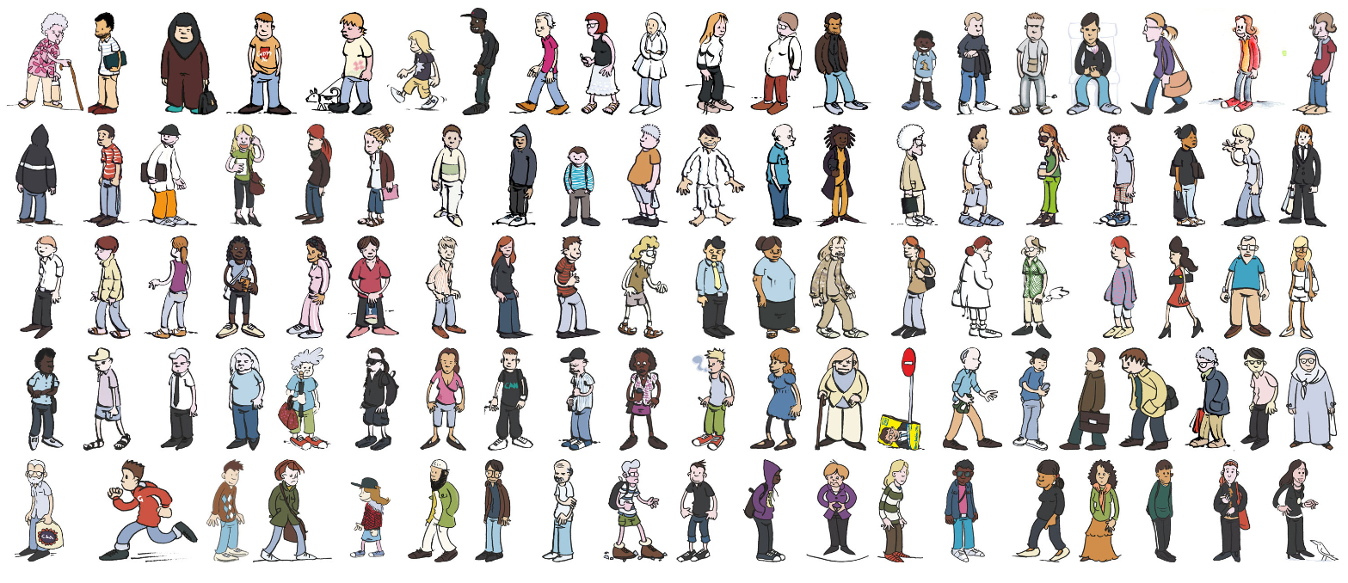
It is about people!

Slide 6
End-user roles
smart consumers, who want to
reduce energy consumption and costs
minimum effort
smart customers, who want to get services to become
a prosumer, i. e. produce as well as consume energy or provide energy services
a market partner with providing consumption flexibility or energy services
smart citizens, who want to
become part of a ‘smart energy community’
take responsibility to ensure local energy supply and environment preservation

Slide 7
Project setup
WP 7: Management
WP 1: Framing
provides selection criteria
defines scope of research
WP 2: Investigation
provides empirical evidence
WP 3: Assessment
engages test partners
delivers good practice
provides guidelines
WP 5: Test
WP 4: Guidance
ensures practicability
ensures trust
delivers proven means
WP 6: Rollout

Slide 8
Theory
What drives end-user behaviour?
Social-psychology, economics, sociology, innovation
How to classify end-user behaviour?
Segmentation approaches
How to engage end-users?
Communication & (social) marketing approaches

Slide 9
Recent experiences with …
Incentive-based programs & pricing schemes
End-user feedback (channels & content)
End-user engagement and communication
Privacy & security
Role of end-users in new market structures (aggregation)
Experiences from mobile phone and ICT

Slide 10
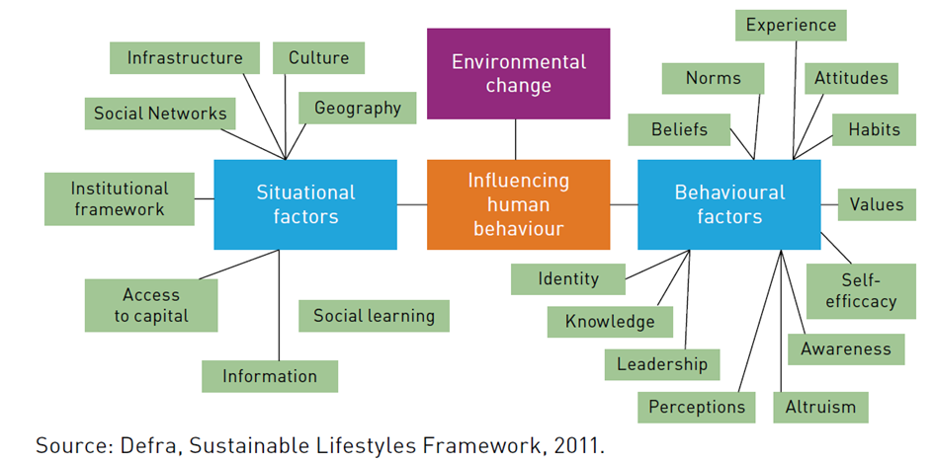
What drives end-user behaviour?
Notes:
Many factors
Behavioural & situational
Conscious and habitual

Slide 11
Energy-related practices
Energy is not used consciously or rationally, but rather as the ‘byproduct’ of:
cooking, washing, showering, working, commuting, watching TV, socialising, and travelling
Driven by routines and socially shaped expectations
Practices are continuously evolving, for example:
Comfort, cleanliness, convenience (Shove, 2003)
So it is not about a financial incentive, but rather about how smart grid technology interferes with energy related practices

Slide 12
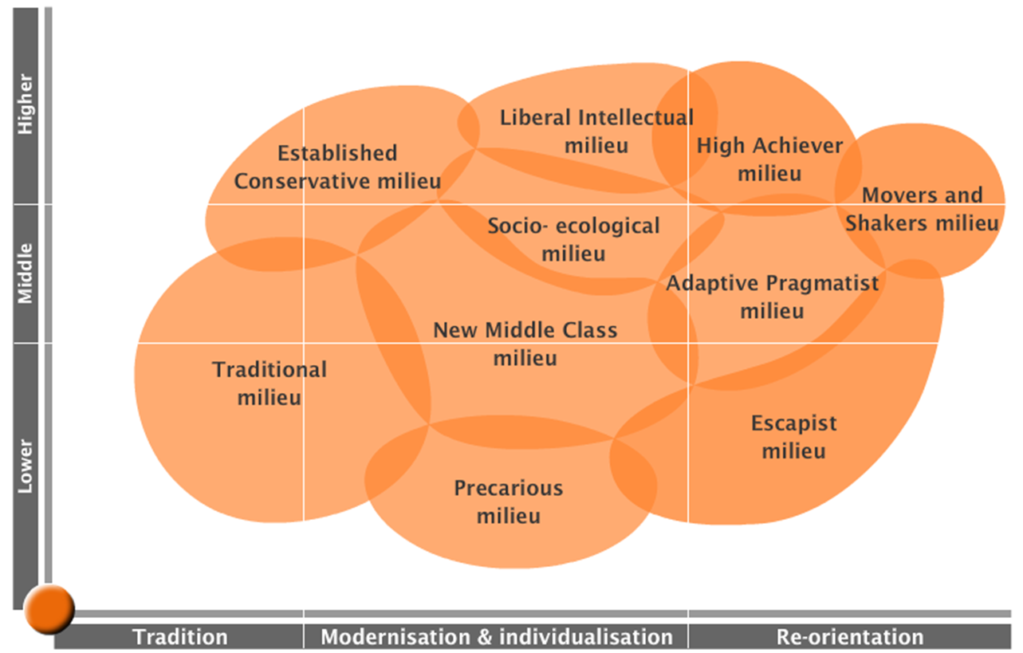
How to classify end-user behaviour?
Sinus milieus:
Sutterlin et al. (2011):
Idealistic savers (16%)
Selfless inconsistent energy savers (26%)
Thrifty energy savers (14%)
Materialistic energy consumers (25%)
Comfort-oriented indifferent energy consumers (5%)
Problem conscious welfare-oriented energy consumers (14%)

Slide 13
How to engage end-users?
4P’s marketing mix
product, price, promotion, place
AIDA model
attention interest, desire, action
Cialdini’s principles of influence
reciprocity, commitment, social proof, liking, authority, scarcity
Defra’s 4E model
enable, encourage, engage, exemplify
Social marketing:
Clear behavioural goals, Customer orientation, Theory, Insight, Exchange, Competition, Segmentation, Methods mix
Promoting energy investments:
Emotional appeals, Rational appeals, Build trust and confidence, Provide transparent and understandable information, Provide support and services

Slide 14
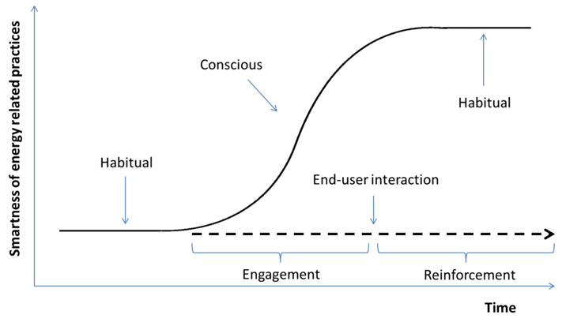
Framing the process

Slide 15
Enablers & Barriers
Category | Enablers | Barriers
Comfort | Comfort (gain) | Comfort (loss)
Control | Additional control options (participation electricity market, advanced control of appliances, ‘energy autarky’) | Loss of control over appliances
Environment | Environmental benefits
Finances | Financial or in kind incentives, Lower energy bill | Investment costs Increased energy bill
Knowledge & Information | More transparent and frequent billing Detailed knowledge about electricity use | In adequate information provision Lack of end-user competences Lack of awareness
Security | Improved reliability of energy supply | Privacy and security concerns
Social process | Role models Customer testimonials Community feelings Competition Fun | Free rider effects Job losses
Notes:
Main points:
Diversity of Variety of factors certainly not only monetary incentives
For each end-user, different factors will play a role

Slide 16
How to engage? – Engagement phase
Provide added value: e.g. attractive financial incentives, comfort gains rather than losses, providing new information services, ensuring data privacy and security etc.
Understand end-users: Different target groups may be susceptible to very different enablers and barriers.
Educate end-users: Information and training to relieve knowledge & information barriers.
Create commitment & appeal: Taking full advantage of social processes as an important enabler, e.g. through end-user participation, role models, and marketing (the ‘Apple’ approach).

Slide 17
How to engage? – Reinforcement phase
Effective feed-back, pricing & communication
Variety of intervention methods: e.g. feedback information and channels, dynamic pricing schemes
Ease of use: User-friendly, intuitive designs, adequate and pro-active support and service
Social comparison: Allow comparison, appeal to the competitive nature of people
Reflection & learning: Expectations, flexibility, monitoring and evaluation

Slide 18
Where do we (really) want to know more about?
Understanding the target group(s) and matching their specific needs and situations
Products & services with real added value
Pricing schemes, feedback, communication and synergies
Involvement of ‘non-energy’ stakeholders
Bottom-up support: ‘citizen projects’
New market structures and the role of end-users
Scalability and replicability

Slide 19
Conclusion
An end-user centered approach is needed
Behavioural and situational factors
Conscious and habitual behaviours (practices)
Enablers and barriers
One-size fits all is not an option
Tailor made and diversify
Much is known, but:
No blueprint, rather ‘checklists’
Insights somewhat scattered
Not always clear how things are done
Key challenges remain

Slide 20
Next steps
Analysis of a suite of smart grid projects in Europe
Quantitative & qualitative (interviews)
Identify ‘success factors’
Differentiating engagement strategies for different roles
Consumer, Customer, Citizen
Working towards tools and guidelines to engage end-users in smart energy behaviour.

Slide 21
Further info
Pieter Valkering
pieter.valkering@vito.be
Erik Laes (coordinator)
erik.laes@vito.be
S3C deliverable 1.1
http://www.s3c-project.eu/

Slide 22
Key challenges 1
Develop products and services with added value for end-user and ‘the grid’
Matching end-user needs and profiles (e.g. through segmentation)
Assess effectiveness of (combinations of) tools and methods
Up-scaling and replication
More effective marketing and outreach
New market designs and end-user roles (legislation/privacy)
Facilitate and assess ‘citizen projects’ (context & conditions)

